Slide 1

RideWise: Customer Churn Prediction & Analytics Engine
Industry: European Mobility

Slide 2


RideWise: Empowering Urban Mobility
RideWise is a leading mobility technology company with operations across key European cities:
Key Challenges We Face:
High Churn Rate: A significant 25% quarterly customer churn.
London
Berlin
Amsterdam
Revenue Erosion: An estimated £8M in annual revenue loss due to churn.
Barcelona
Milan
Delayed Insights: Manual customer analysis hinders agile decision-making.
Serving over 200,000 active customers and facilitating 800,000 monthly trips, we are at the forefront of urban transportation.
No Proactive Retention: Lacking predictive capabilities to retain at-risk users.

Slide 3

Understanding the Business Problem: Churn's Impact
Revenue Loss Drivers
50,000 customers churn annually, directly impacting our bottom line.
Each churned customer represents £160 in lost average lifetime value.
Only a 12% uptake on promotional offers indicates a low return on marketing investment.
Operational Problems
Absence of an early warning system for users on the verge of churn.
Our current promotional strategies are generic, leading to poor personalization and effectiveness.
Customer insights are delayed by weeks, preventing timely interventions.

Slide 4





Project Rationale: Investing in Retention
Customer retention is 5–7x cheaper than customer acquisition.
Predict Churn in Advance
Enable Targeted Campaigns
Identify at-risk customers up to 30 days prior to their potential churn event.
Design and execute highly personalized retention campaigns that resonate with specific user segments.
Improve Marketing ROI
Real-time Risk Scoring
Optimize marketing spend and resource allocation by focusing on high-impact retention efforts.
Provide instant customer risk assessments via a robust Machine Learning API.
Expected Annual Savings: Over £3.2M from a reduction in customer churn.

Slide 5



Project Objectives: A Multi-faceted Approach
Data & Analytics
Machine Learning
MLOps & Deployment
Develop comprehensive customer segmentation (3–5 distinct groups).
Implement and compare Logistic Regression, Random Forest, and XGBoost models.
Build a robust FastAPI prediction service for real-time inference.
Conduct extensive Exploratory Data Analysis (EDA) to uncover churn patterns.
Deploy the service on AWS EC2 instances.
Perform advanced feature engineering, including RFM (Recency, Frequency, Monetary) and behavioral features.
Establish Continuous Integration/Continuous Deployment (CI/CD) with GitHub Actions.
Achieve model performance with AUC score greater than 0.80.
Implement basic monitoring capabilities using CloudWatch.

Slide 6
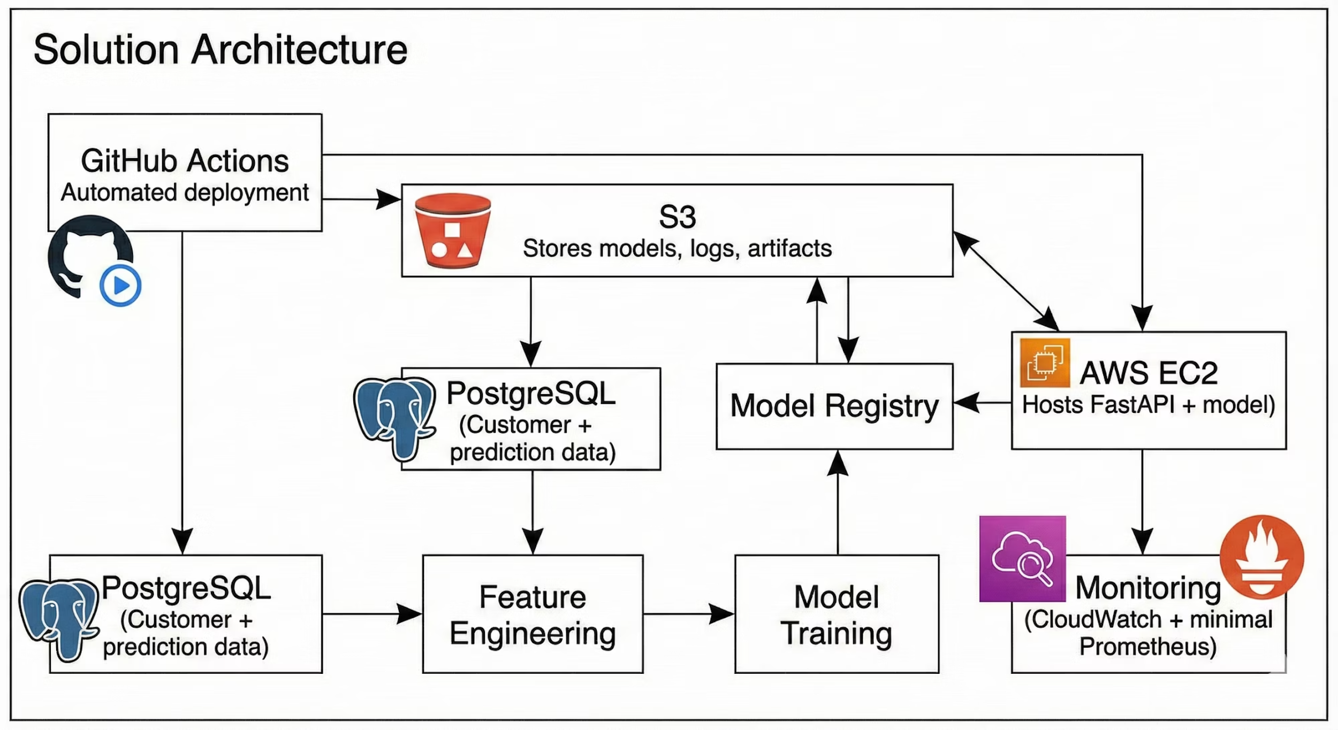
Solution Architecture: Powering Predictive Insights
End-to-End Pipeline: Data Ingestion → Feature Engineering → Model Training → Model Registry → API Deployment → Continuous Monitoring

Slide 7
3-Week Sprint: Agile Implementation Plan
1
Week 1: Data & Analytics Foundation
Focus: Understanding the customer landscape.
Extensive EDA and customer segmentation.
RFM analysis to categorize customer value.
Discovery of behavioral patterns tied to churn.
2
Week 2: ML & ML Ops Setup
Focus: Model development and foundational MLOps.
Training of three distinct churn prediction models.
Implementation of MLflow for experiment tracking.
Development of FastAPI service and Docker containerization.
3
Week 3: Deployment & Monitoring
Focus: Operationalization and observability.
Deployment of the prediction service to AWS EC2.
Activation and testing of the CI/CD pipeline.
Setup of basic monitoring dashboards and comprehensive documentation.

Slide 8
Key Deliverables: Tangible Outcomes
Technical Deliverables
Business Deliverables
Fully functional customer segmentation model.
Comprehensive churn insights report highlighting key drivers.
High-performance churn prediction model (AUC ≥ 0.80).
Detailed profiles for identified customer segments.
Deployed FastAPI prediction service for real-time inference.
Actionable recommendations for targeted retention strategies.
Containerized application via Docker and robust CI/CD pipeline.
Essential monitoring dashboard for system and model performance.

Slide 9
Success Metrics: Measuring Our Impact
Our project's success will be evaluated against both technical and business-centric key performance indicators.
Model Metrics
System Metrics
Business Impact
AUC: Achieve > 0.80 for strong classification performance.
API Latency: Ensure response times are < 500ms for real-time applications.
Churn Reduction: Decrease the quarterly churn rate from 25% to 15%.
Precision@Top 15%: Maintain > 70% to ensure effective targeting of high-risk customers.
Uptime: Maintain 99.5% availability to guarantee continuous service.
Campaign ROI: Significantly increase the return on investment for retention marketing efforts.
Deployment Capability: Enable weekly, reliable model and service updates.
F1-score: Sustain > 0.70 to balance precision and recall.

